Slide 1

Gayatri Varna Dhyanamu
Pt.ShriRam Sharma Acharya

Slide 2

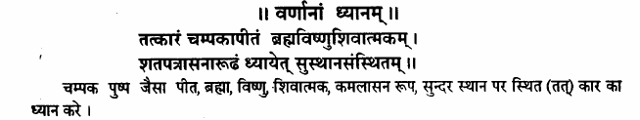
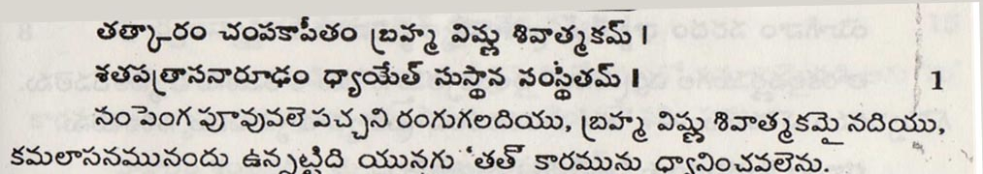
Sloka : 1

Slide 3

Meditate on “Tat”

Slide 4
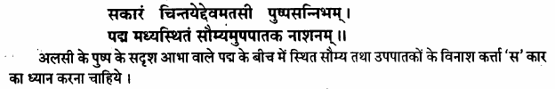
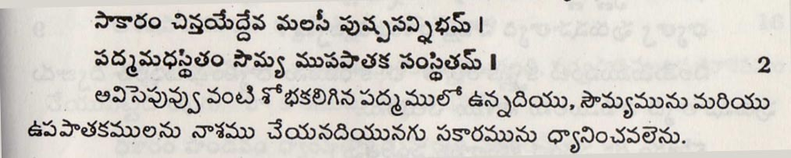
Sloka: 2

Slide 5
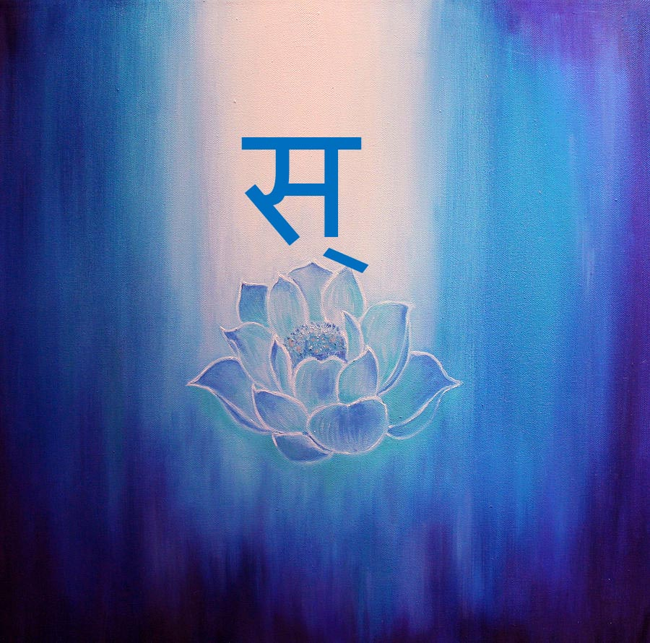
“Meditate on “Sa”

Slide 6

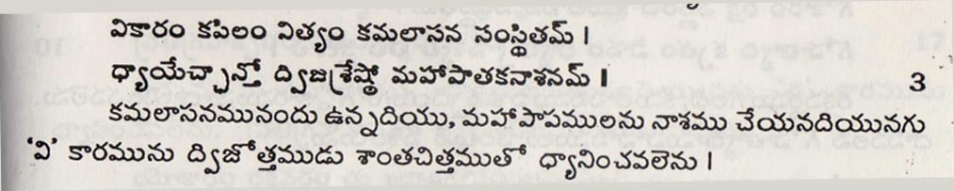
Sloka : 3

Slide 7

Meditate on “Vi”

Slide 8

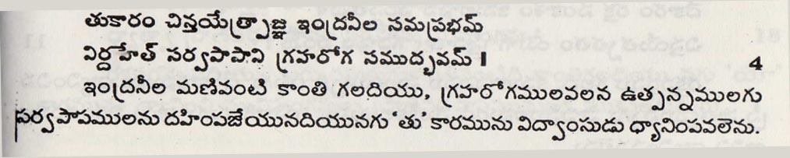
Sloka : 4

Slide 9

Let us meditate on “Tu”

Slide 10
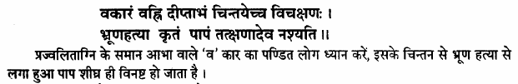
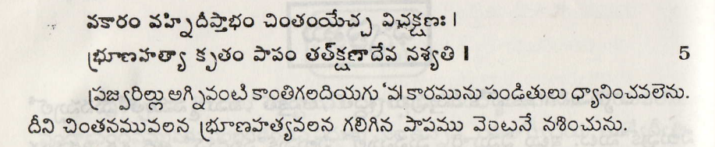
Sloka : 5

Slide 11

Meditate on “Va”

Slide 12

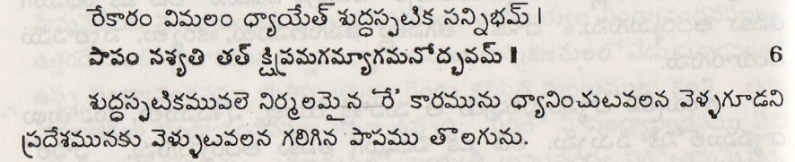
Sloka:6

Slide 13

Let us meditate on “Re”

Slide 14

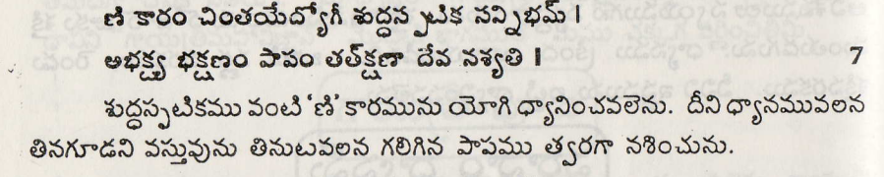
Sloka : 7

Slide 15

Meditate on “Nni”

Slide 16
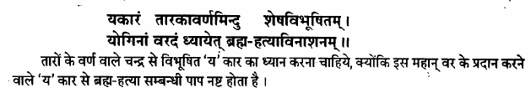
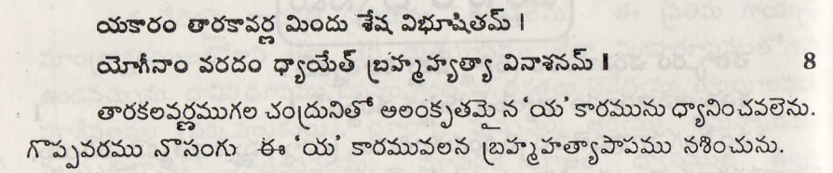
Sloka: 8

Slide 17

Let us meditate on “ Yam”

Slide 18
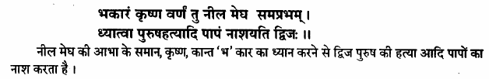
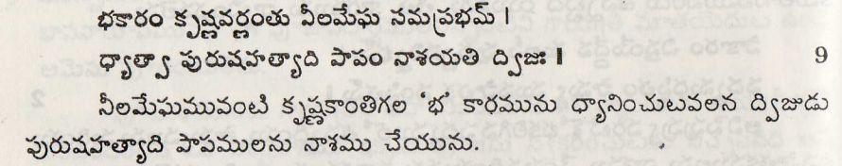
Sloka : 9

Slide 19
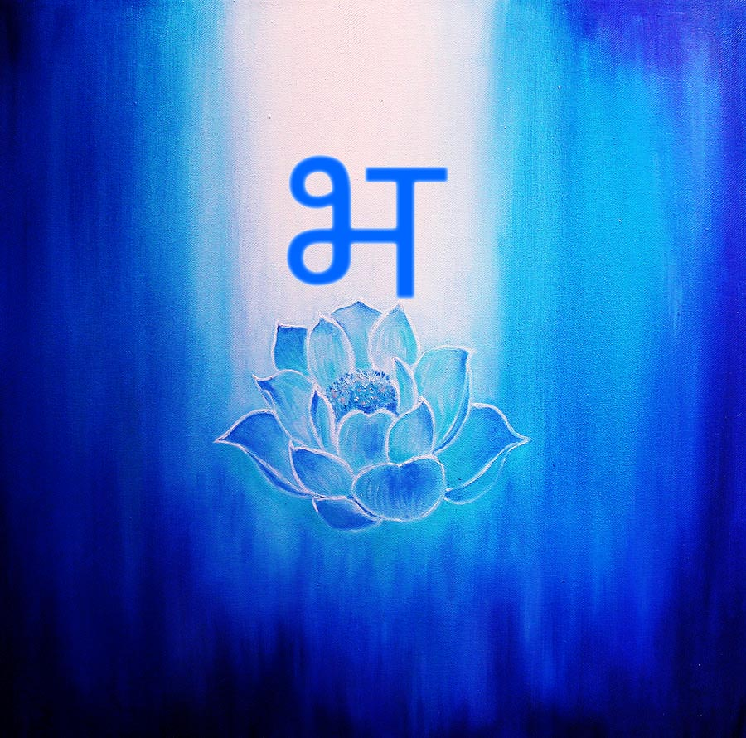
Let us meditate on “Bha”

Slide 20
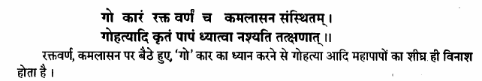
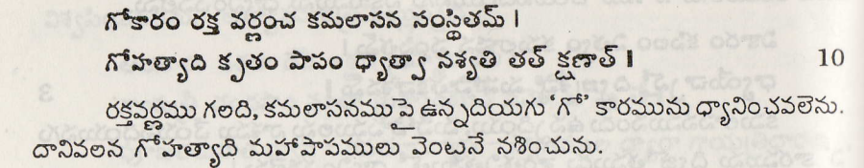
Sloka: 10

Slide 21

Meditate on “Go”

Slide 22

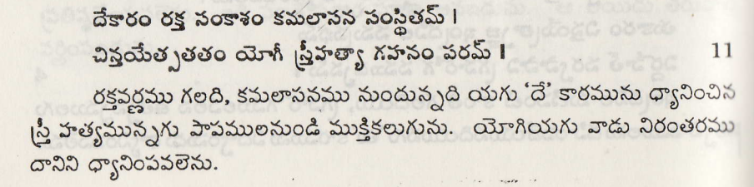
Sloka: 11

Slide 23

Let us meditate on “De”

Slide 24
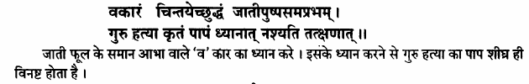
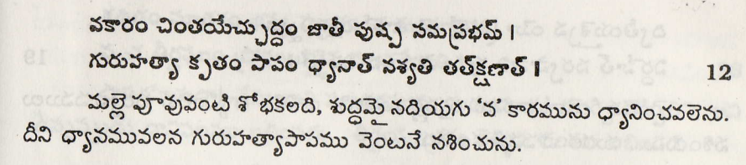
Sloka: 12

Slide 25

Meditate on “Va”

Slide 26

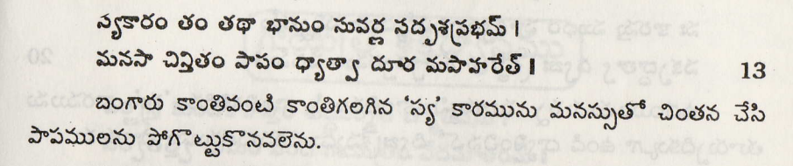
Sloka: 13

Slide 27

Meditate on “Sya”

Slide 28
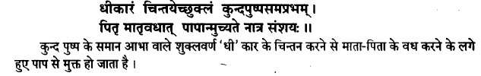
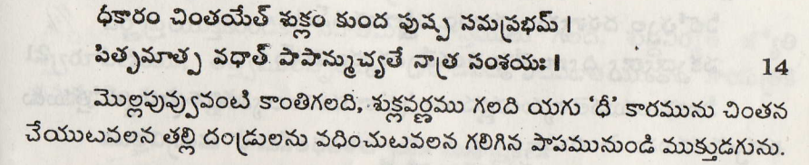
Meditate on “Dhi”

Slide 29

Meditate on “Dhee”

Slide 30
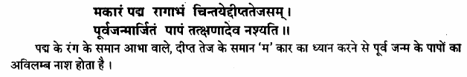
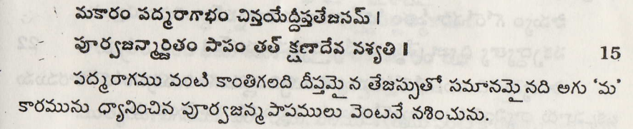
Sloka: 15

Slide 31

Meditate on “Ma”

Slide 32
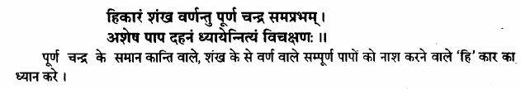
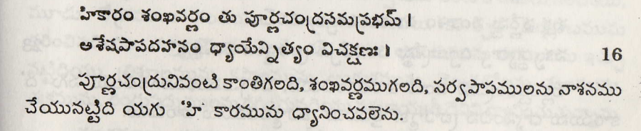
Sloka: 16

Slide 33

Meditate on “Hi”

Slide 34

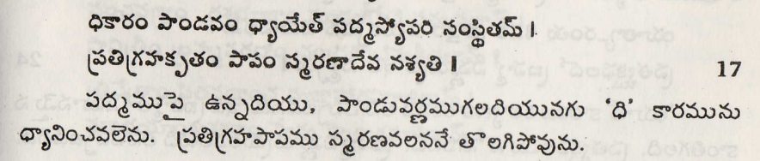
Sloka: 17

Slide 35

Meditate on “Dhi”

Slide 36

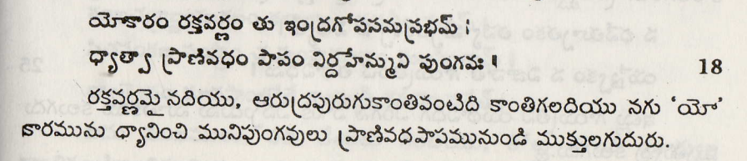
Sloka: 18

Slide 37

Meditate on “Yo”

Slide 38

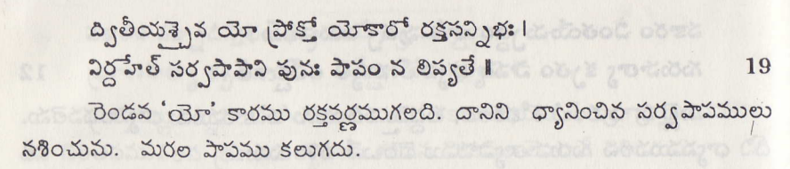
Sloka: 19

Slide 39
“Meditate on “Yo”

Slide 40

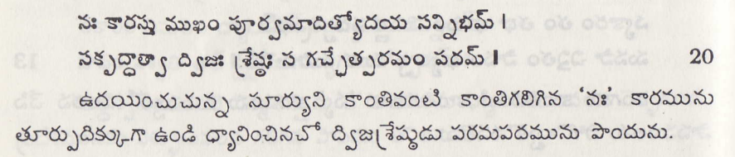
Sloka: 20

Slide 41

Meditate on “Nah”

Slide 42

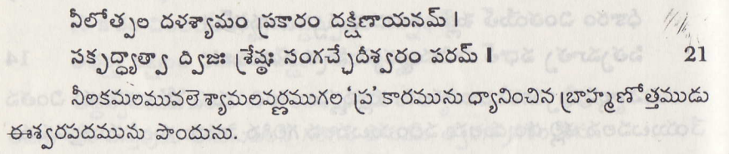
Sloka: 21

Slide 43
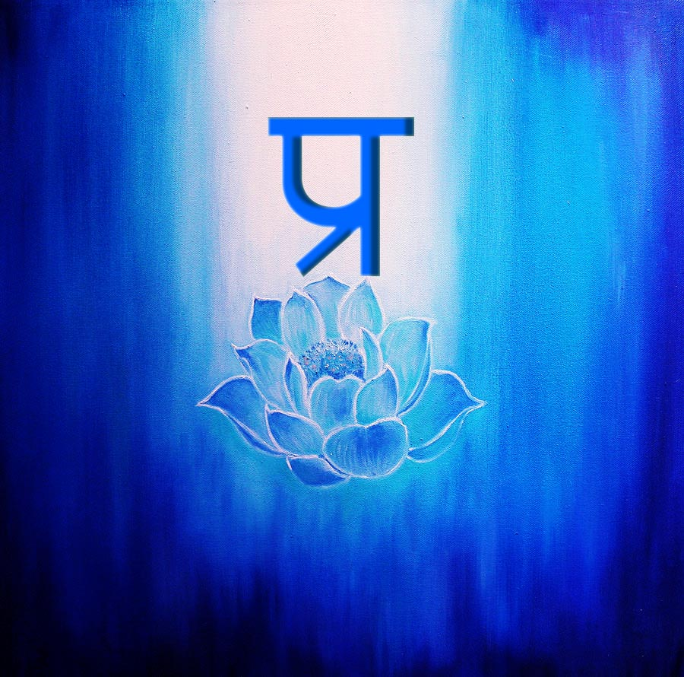
Meditate on “Pra”

Slide 44
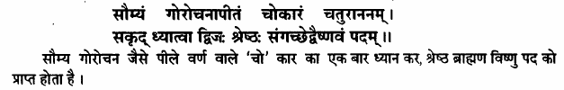
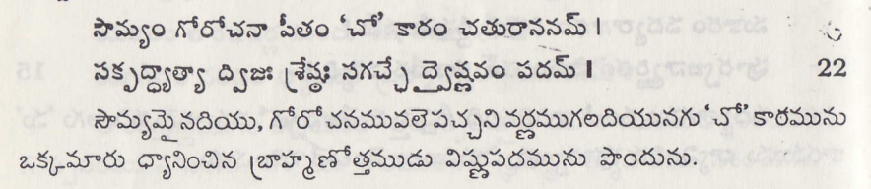
Sloka: 22

Slide 45

Meditate on “Cho”

Slide 46

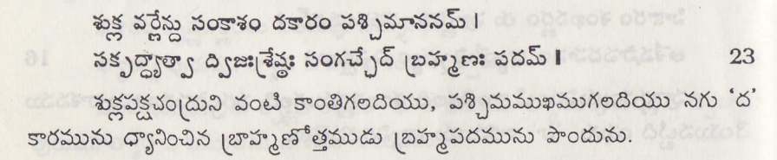
Sloka: 23

Slide 47

Meditate on “da”

Slide 48
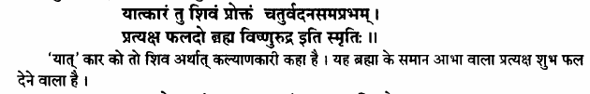
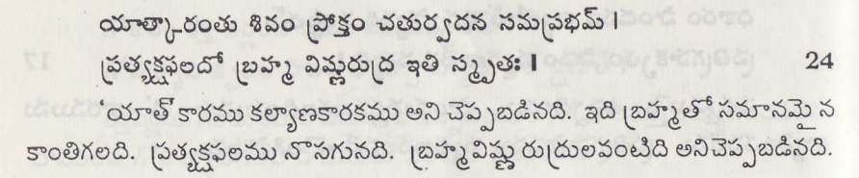
Sloka: 24

Slide 49

Meditate on “Yaat”

Slide 50
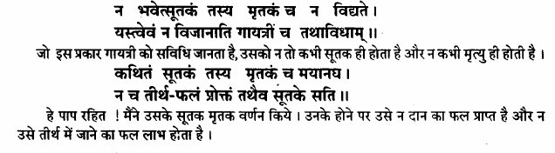
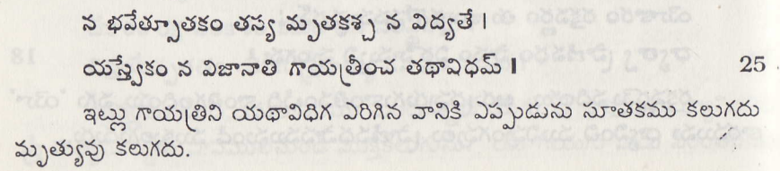
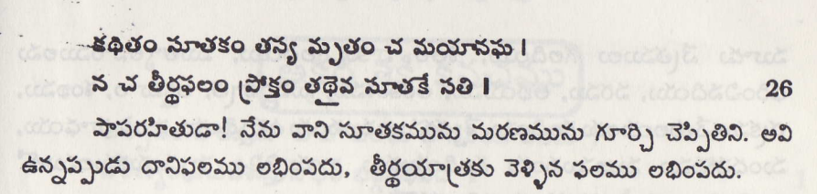
Sloka: 25. 26

Slide 51
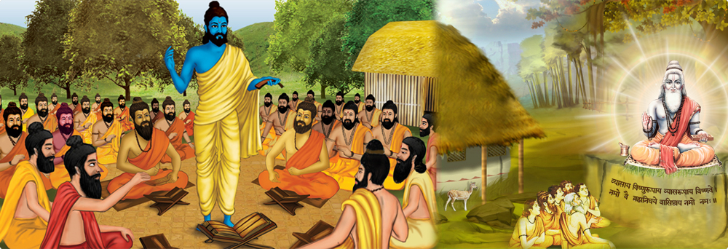
Sandeepani Gurukul
Note : These slides are for students of Sandeepani Gurukul who want to practice and perfect The Super Science of Gayatri or Gayatri Vidya to serve humanity.

