Slide 1


MESSAGE
TO
HUMANITY
Hello
My name is planet Earth
Hearty Welcome to this presentation
Planet Earth

Slide 2
Lets Talk few things about myself and you.
Lets take a tour ..

Slide 3
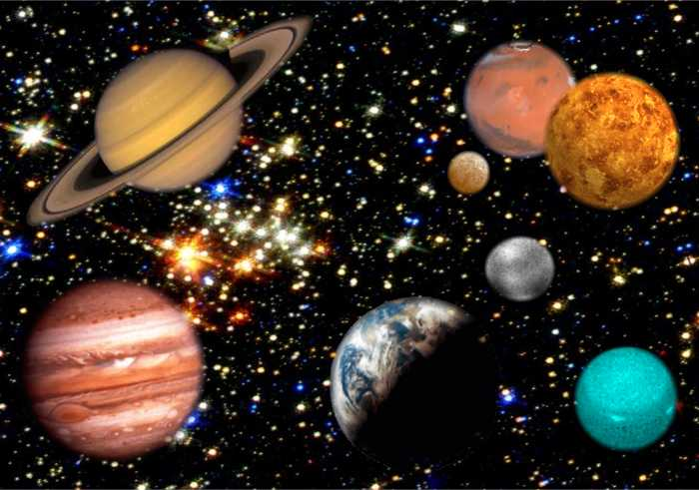

Unimaginable Vastness of the Universe
Over 100 Billion Galaxies
Over 100 Billion Stars
The SUN IS JUST ONE OF MANY BILLION STARS
I AM HERE
840,000 LIVING SPECIES
Human being is just one of those species

Slide 4
We may belong to different countries, cultures however Please do remember that we are the citizens of the same PLANET
I know that you may be busy thinking about yourself, your family, career, etc
Can you spare few minutes and think a big picture by going beyond you and your family?
THINK GLOBALLY AND AS A WORLD CITIZEN TAKE TIME TO SEE WHAT YOU HAVE ACHIEVED SO FAR….

Slide 5
OUT OF 840000 LIVING SPECIES , ONLY HUMANBEING IS GIFTED WITH KNOWLEDGE & WISDOM
Air
Water
Minerals, Metals
Fertile land
Natural energies
UNLIMITED SUPPLY OF ALL THE BASIC NEEDS

Slide 6
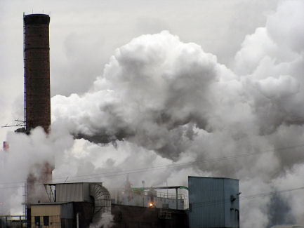
Industrialization
Air & Water Pollution

Slide 7

Nuclear power
Increase in radiation problems

Slide 8

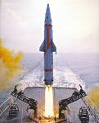
Global warming
Hole in the Ozone layer

Slide 9

Chemical fertilizers & Insecticides
Effect on the Fertility of the Soil

Slide 10

Sound pollution
Negative effect on our mind

Slide 11

Education – only for earning Livelihood
No relation to culture , civilization and human values

Slide 12

Food – only for taste
Not to build a healthy body and mind

Slide 13
ACCORDING TO NEURO SCIENCES
You send Approx 60,000
THOUGHTS EVERY SINGLE DAY
THOUGHT IS A FORM OF ENERGY TOO
POSITIVE THOUGHTS PROMOTE POSITIVE & HEALTHY ATMOSPHERE

Slide 14

MY ATMOSPHERE IS POLLUTED BADLY GREATEST TREAT TO
ME & YOU IS THOUGHTS POLLUTION
Air pollution
Water pollution
Sound pollution
Ground Pollution
Thoughts pollution
Food pollution

Slide 15
Psycho Ecological Pollution
Stress
Unknown Diseases
Tension
This has raised an alarming call for rethinking and guiding the common life style.

Slide 16

There is so much unrest in this world
Political Unrest
Terrorism
Degradation of Moral values
Natural Disasters
Violence
What s Happening?
Can any one do anything about this??

Slide 17
Political Unrest
Terrorism
Degradation of moral values
Natural Disasters
Violence
Wake up People Wake up
Whom you are waiting for?
Why cant you take initiative ??
Don’t end up as a spectator!! Try to
Make a difference ..in little ways.
Take initiative

Slide 18




Where
Are You
Heading ???
What can You do to protect yourselves, your families, your future generations and most important your home Earth?
Is there a solution to curb this negative effects?
OM SANTI SANTI SANTI
Tuesday, July 11, 2017
18

Slide 19
Please don’t put us all in suspense ???
Tell us the solution
GOOD NEWS IS THAT THERE IS A SOLUTION TO ALL THESE CHALLENGES FACED BY YOU

Slide 20
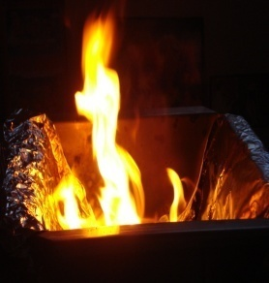
YAGNA
Boon of the Ancient Indian Sciences
From ancient times, Ayurveda & Vedic sciences have made significant contributions to the world civilization, culture and knowledge in all areas of human pursuits

Slide 21
WHY YAGNA
IT IS A SCIENTIFIC TOOL DESIGNED BY ANCIENT SCIENTISTS OF INDIA TO ACHIEVE DESIRED EFFECTS IN PHYSICAL , ENVIRONMENTAL,ECOLOGICAL, SPIRITUAL LEVELS

Slide 22


BECAUSE YAJNA IS BASED NOT ONLY ON FAITH
BUT ALSO ON SCIENCE
Heat
Sound
Energy systems in physical world
HEAT FROM FIRE
SOUND OF MANTRAS
SPREAD MOLECULAR WAVES INTO ATMOSPHERE
Purification of Atmosphere

Slide 23

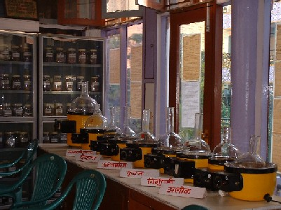
Brahmvarchas Research Institute
Shantikunj, Haridwar , India
INTER-COMMUNION OF SCIENCE AND SPIRITUALITY
This center is dedicated to the integration of the modern and ancient sciences in a practical way motivated by the noble goal of health and happiness for all.
Innovative scientific research aimed at grass root applications is being carried out here in the ancient sciences in an enliven collaboration with the relevant modern sciences.

Slide 24


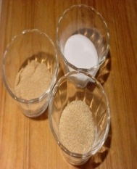

SCIENTIFIC DISCOVERIES AND BENEFITS OF YAGNA
Mixing ghee and sugar and burning them creates smoke which kills the germs causing certain diseases
Secretion takes place from some glands related to the wind-pipe in throat, which fill our heart and mind with pleasure
  If cow’s ghee is put into Yagna fire, its fumes lessen the effect of atomic radiation to a great extent. Ghee also has properties of detoxification. During combustion, nutrients for plants are released in both fine and coarse forms Ghee undergoes many chemical combinations and dissolves toxic compounds. It is the only substance known to modern science, which defies certain laws of chemistry: when ghee is burned under ideal conditions its weight does not alter
GHEE
SUGAR
  IT IS ALSO KNOWN THAT NASA'S MANNED SPACE CAPSULES ARE COATED WITH A THIN LAYER OF COW DUNG TO PROTECT THEM AGAINST RADIATION.

Slide 25
Healthy life
Removes Foul odors
Promotes Health and Protection against harmful diseases
Water purification
YAGNA ASH
Makes it fit for drinking
Agriculture
Agnihotra’s atmosphere and ash can be used as adjutants in the ‘Natural farming’ methods --- also known as the Agnihotra farming methods.
Destroys Harmful Bacteria
Purifies Water
It is a holistic concept of growing plants in healthy atmosphere and maintaining ecological balance by performing Agnihotra (Yagna) in the middle of the farm and using the Yagna - ash as a fertilizer.
It is not only safe and productive but also holistic in its approach towards environment

Slide 26
Bhopal Gas Tragedy and Agnihotra: The incidence occurred on the deadly night of December 3, 1984, when the poisonous MIC gas leaked from Union Carbide. Hundreds of people died and thousands were hospitalised. There were, however, two families ---Shri. Sohan Lal S Khushwaha and Shri. M.L. Rathore, who lived in the worst affected area, one mile away from the plant came out unscathed as they were regularly performing Agnihotra (Havan). In these families, none died. Nobody was even hospitalized despite of being present in the area worst hit by the toxic gas.
This observation proves that Agnihotra is a powerful antidote to pollution. (cf. News Paper ‘The Hindi’ of 4-5-85; news item under the heading ‘Vedic Way to Beat Pollution’).

Slide 27

At the defense institute of physiology and allied sciences (DIPAS) New Delhi, Dr. Selvamurthy (Sr. Scientist) studied the physiological effects of Agnihotra
on the human mind and body. It was observed that during the performance of Agnihotra, the heart rate showed a declining trend, body temperature was
raised, GSR remained significantly higher, ECG showed DC shift in base, EEG showed constant changes, power in Alpha band increased, while there was a
tendency of suppression in delta power. t has been concluded that Agnihotra atmosphere has distinct beneficial effects on mind and body leading to mental
tranquility.

Slide 28

Subtle effects of Yagna
The sacred fire acts as a link between man's consciousness and the cosmic consciousness
A Few things being:
1. Cleansing of the atmosphere
2. Cleansing of the physical and psychic bodies
3. Awakening of auspicious energies

Slide 29
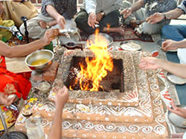
Air pollution
Water pollution
Sound pollution
Ground Pollution
Thoughts pollution
Food pollution

Slide 30
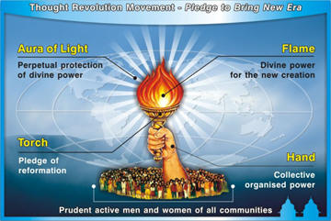
AWGP
ALL WORLD GAYATRI PARIWAR
Haridwar , INDIA
GLOBAL MOVEMENT FOR TRANSFORMATION OF THOUGHTS
INVITES YOU ALL

Slide 32
Yajna
YA
Production
Ja
Earning
Na
Distribution
ASVAMEDHA YAJNA
ASVA AS+KVAN
=One who possesses fast Speed
Medha – Supreme Wisdom &
Intelligence
ASVAMEDHA YAJNA
Combination of valour, strength and illumined power of intellect.
There are many types of Large scale Yajnas

Slide 33
Asvamedha Yajna –King of Yajnas
The one that awakens Medha
(Intelligence) is Aswamedha Yajna
Yajnas performed at large scale
Gives desired results in physical and subtle worlds
The Yajna is a unique combination of the
sciences of emotion, psychology,
Hymns, physics and chemistry

Slide 34
ALL WORLD GAYATRI PARIWAR CORDIALLY INVITES YOU TO TAKE PART IN THIS LARGE SCALE
ASVAMEDHA YAGNA
Jan 05 to 08 & January 2018
Mangalagiri, Guntur District, Andhrapradesh

Slide 35


COME JOIN HANDS TOGETHER

Slide 36
Ok People Do not forget to offer your sincere gratitude to Spiritual scientists of present age
PT SRIRAM SARMA ACHARYA
(GAYATRI PARIVAR -HARIDWAR) and His disciples
DR PRANAV PANDYA – HEAD OF AWGP,
DR RK of ANDHRA PRADESH
for reviving this ancient wisdom and science behind Gayatri Mantra and Yagna .
LAST BUT NOT THE LEAST OFFER YOUR SINCERE GRATITUDE AND UTMOST REVERENCE TO
GREAT ANCIENT SPIRITUAL SCIENTISTS EVER PRESENT RISHIS FOR BLESSING YOU ALL WITH THIS ANCIENT WISDOM AND KNOWLEDGE.

Slide 37
Thank you for listening to me. You people must be really excited to know about the science & Benefits of Yajna
For more information please feel free to contact

Slide 38
THANK YOU VERY MUCH
MOTHER EARTH
Thank you for waking us up
We will do our best to be a good world citizen not just in words but in actions.
We dedicate a portion of our income, time and resources for the welfare of this global family to make our home-the Earth a better place to live!!

Slide 39
ALL WORLD GAYATRI PARIWAR SOUTH
I am very happy to hear this!!Keep your promise and be a responsible citizen of this world !! Build a Better World by building Better Families, Better Societies and better Nations!!
Work together to Bring heavenly atmosphere
www.awgpsouth.org

